Slide 1
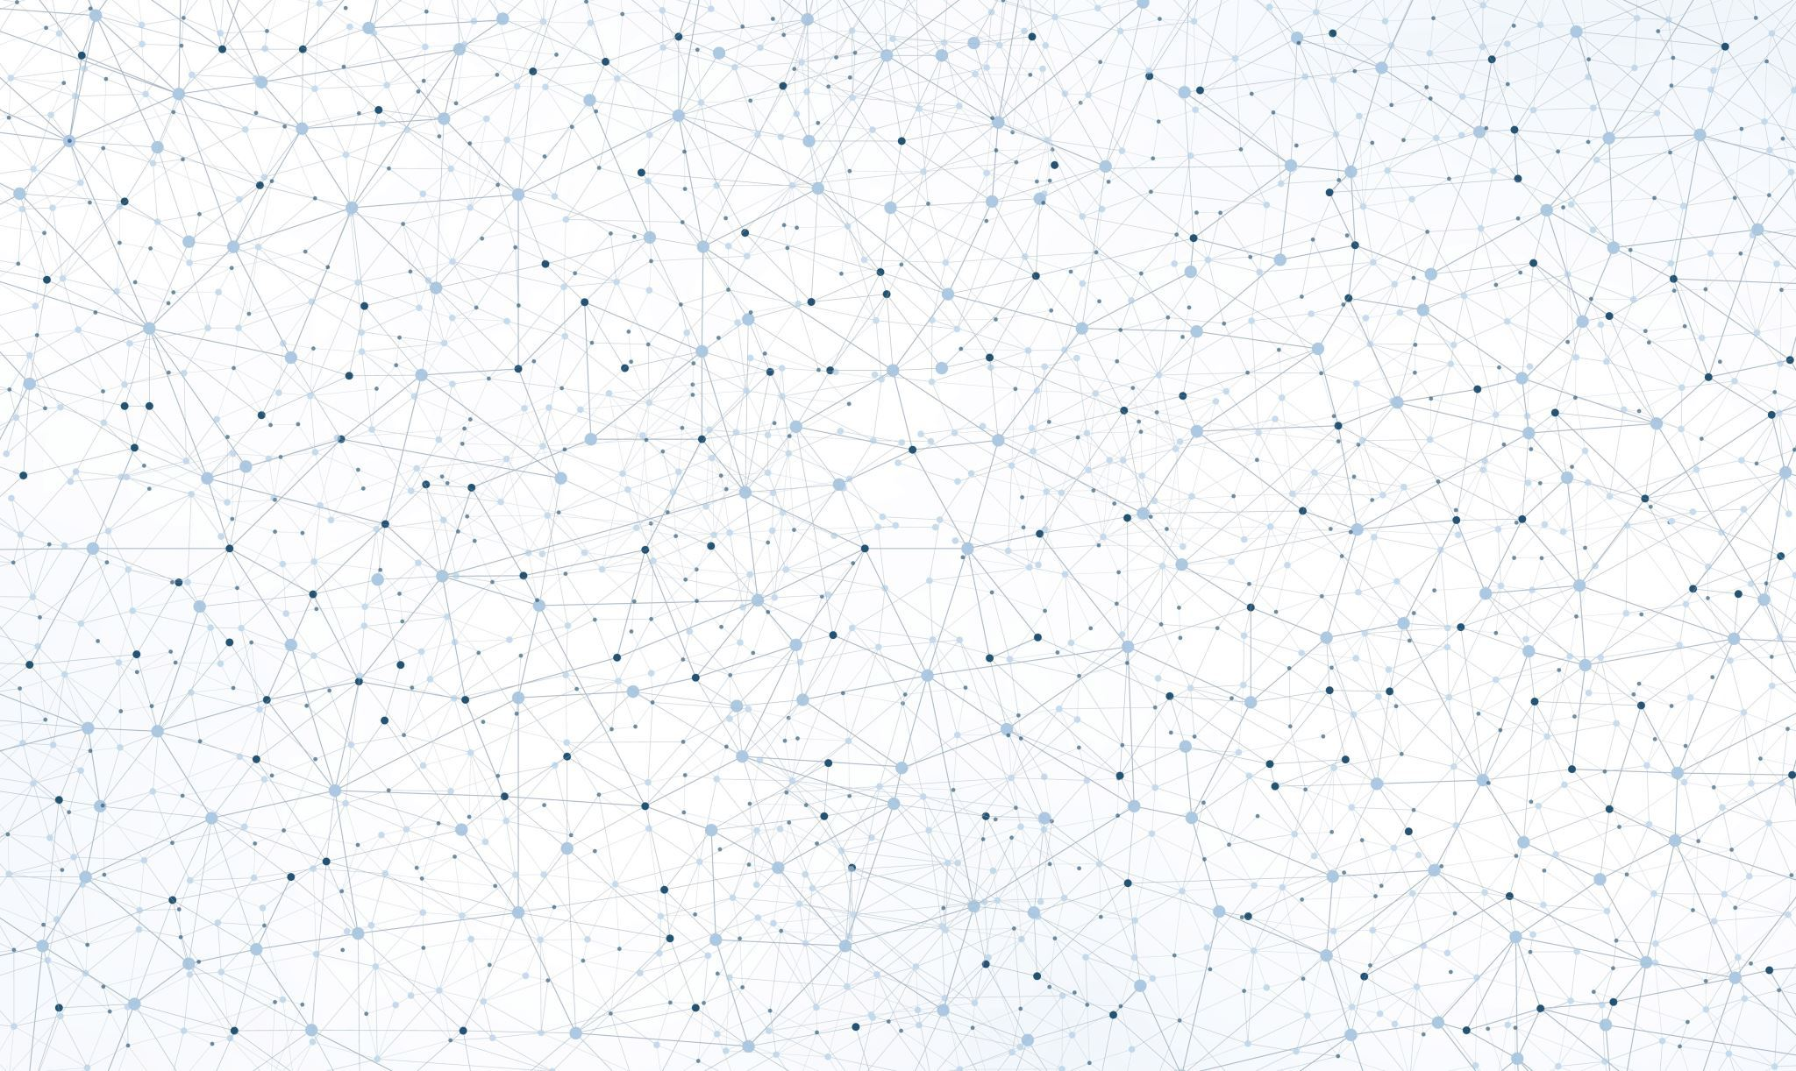
Himanshu Sahni, Sheik Meeran Rasheed Abdul Rahuman, Estéban Nocet-Binois,
Vasiliki Kostara, Cyrene Howland
Image-to-Image
Translations Using
GANs

Slide 2
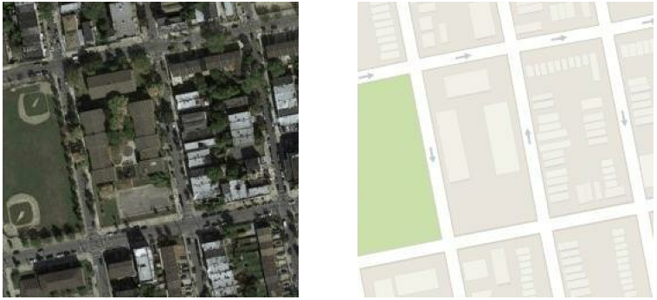
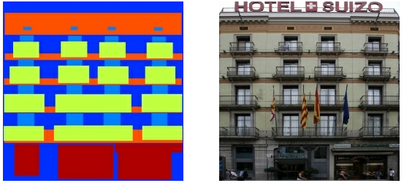
Introduction: Image-to-image translation
Satellite to map
Converting occurrences between two visual domains
Applications
Style transfer
Restoration and image inpainting
Image synthesis
Resolution enhancement
The datasets we used
Semantic to photo translations
Facades to photos
Satellite to maps
Applications
Data augmentation
Image editing
Visualization (design, architecture, etc)
Animation (animated films, games, etc.)
Facade to photo

Slide 3
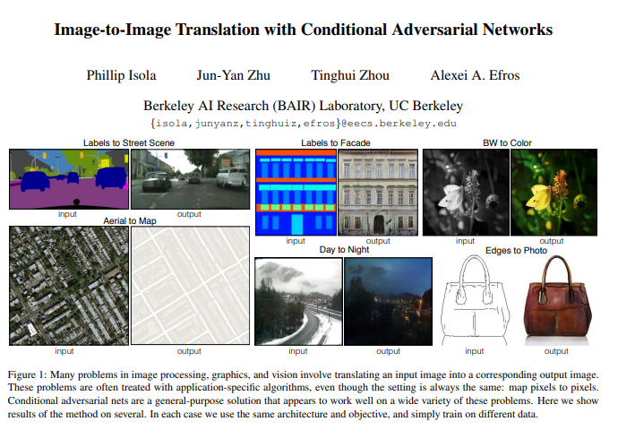
Introduction: cGANs and Pix2Pix
Generative Adversarial Network
Conditional GAN
Pix2Pix – An Implementation of Conditional GAN

Slide 4
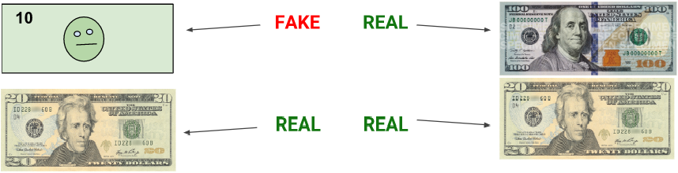
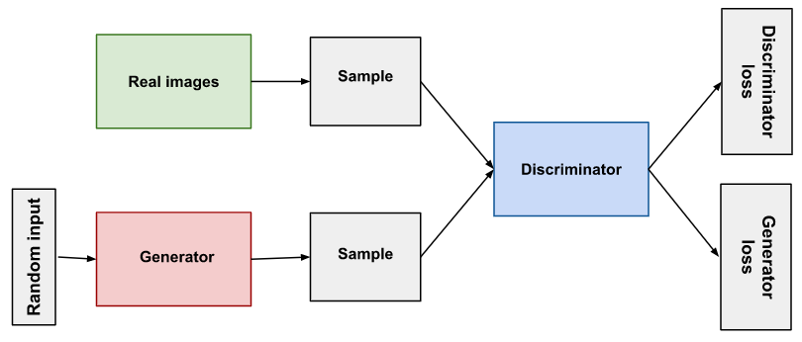
Generative Adversarial Networks - GANs
Goal: Create counterfeit as realistic as possible
GANs consists of two competing networks:
Generator
Creates fake data and trains to improve their quality.
Discriminator
Tries to detect and classify the generator's output as fake.
The training processes for the generator and the discriminator do not happen
simultaneously, but iteratively until convergence.
https://developers.google.com/machine-learning/gan
Notes:
Generative adversarial networks are essentially used to produce synthetic outputs,
that cannot be distinguished from real instances.
Typically, GANs consist of two neural networks, the generetor that creates fake data as realistic as possible
and the discriminator, which in turn tries to detect them.
As the name suggest, the two networks are trained to be adversaries.
The training processes do not happen simultaneously,
but iteratively until convergence.

Slide 5
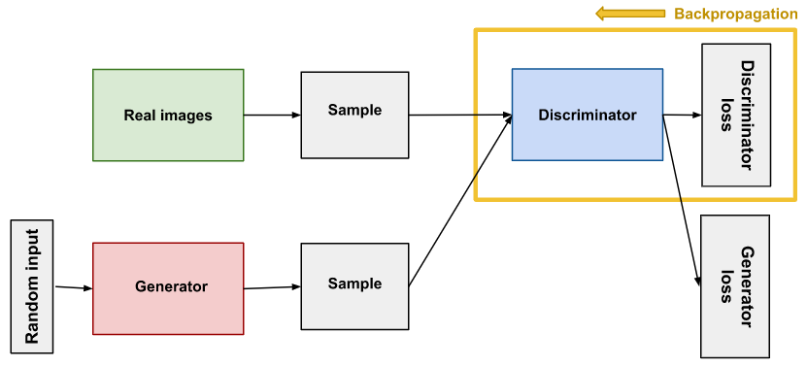
Discriminator: Classifier that distinguishes real data from data created by the generator.
Two Inputs:
Samples from real instances
Synthesized samples by the generator
Produces Two Losses:
Discriminator Loss
Generator Loss
Discriminator Training:
Classifies both real and fake data.
Penalized for missclassifying real as fake or the opposite.
Updates weights through backpropagation (through itself) from the discriminator loss.
https://developers.google.com/machine-learning/gan
Notes:
In particular, the discriminator is a classifier, that distinguishes real data, from those created by the generator.
It receives two inputs:
Samples from real instances +
Samples synthesized by the generator
According to the classification, two losses are calculated,
one for the discriminator and one for the generator.
The former loss penalizes the discriminator for missclassifying real as fake or the opposite
The latter signifies the generator failing to fool the discriminator.
Finally, the discriminator weights are updated from the discriminator loss through backpropagation through its network.

Slide 6
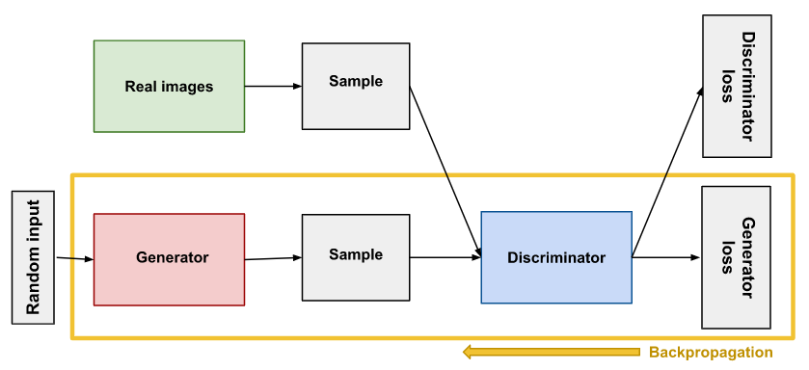
Generator: Trains to make the discriminator classify the fake sample as real by taking feedback from it.
Input:
Random noise vector
Output:
Synthesized data instance
Generator Training:
After the discriminator classification:
Generator loss penalizes the generator for failing to "fool" the discriminator.
Backpropagation through both discriminator and generator
BUT
Only the generator weights get updated.
https://developers.google.com/machine-learning/gan
Notes:
On the other hand, the generator trains to make the discriminator classify the fake sample as real.
It receives feedback from the discriminator in the form of the generator loss.
Firstly, though,
In order to create any synthesized output to provide to the discriminator, the generator needs some sort of input.
For the general GAN model this is a random noise vector, but it varies for other types of GANs.
After the calculation of the two losses,
Backpropagation flows through both the discriminator and the generator. However, only the generator weights are updated.

Slide 7
When does the GAN converge?
Ideally when the discriminator
cannot successfully distinguish
fake from real!
Discriminator
Classification becomes fully random (coin-flip).
GAN
convergence is a dynamic process, rather than a stable state.
Generator
if training commences after convergence,
Discriminator becomes unreliable.
the generator receives unreliable feedback,
decreasing its output quality.
https://developers.google.com/machine-learning/gan
Notes:
So when soes the GAN converge?
Ideally when the discriminator cannot successfully distinguish fake from real.
This means that the discriminator classifies its inputs randomly, as if flipping a coin.
However, since the generator training is based on feedback from the discriminator,
The fake data quality might decrease.
Therefore, convergence is a dynamic process, rather than a stable state.

Slide 8
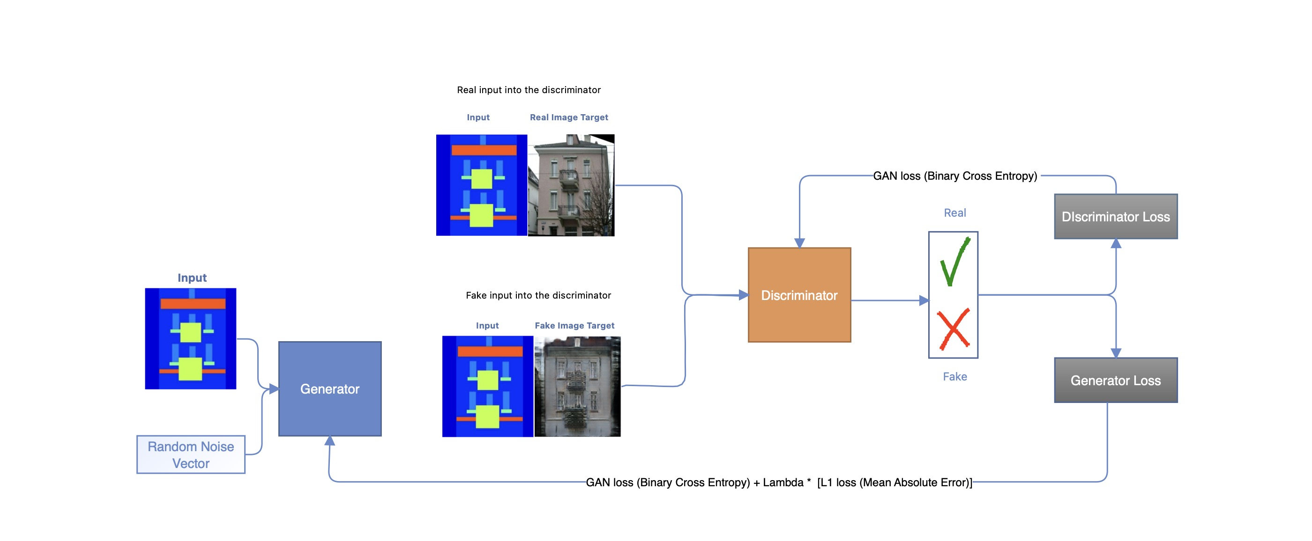
Conditional GANs (cGANs)
Notes:
With basic GANs you can't control the type of images created. Basic GANs is blindly trained using the random noise vector so you don't know the mapping of the latent vector space to the actual features in the image (the actual attributes of the image that you are trying to generate)
A conditional GANs is where both the generator and discriminator models are conditioned on class labels, or other modalities. We used an image modality to condition our GANs. This allowed us to generate images of the type specified by our input.
Basic GANs learns a loss that adapts to the data, while cGANs learns a structured loss that penalizes a possible structure that differs from the network output and the target image. This allows the generated image to become structurally similar to the target image.

Slide 9
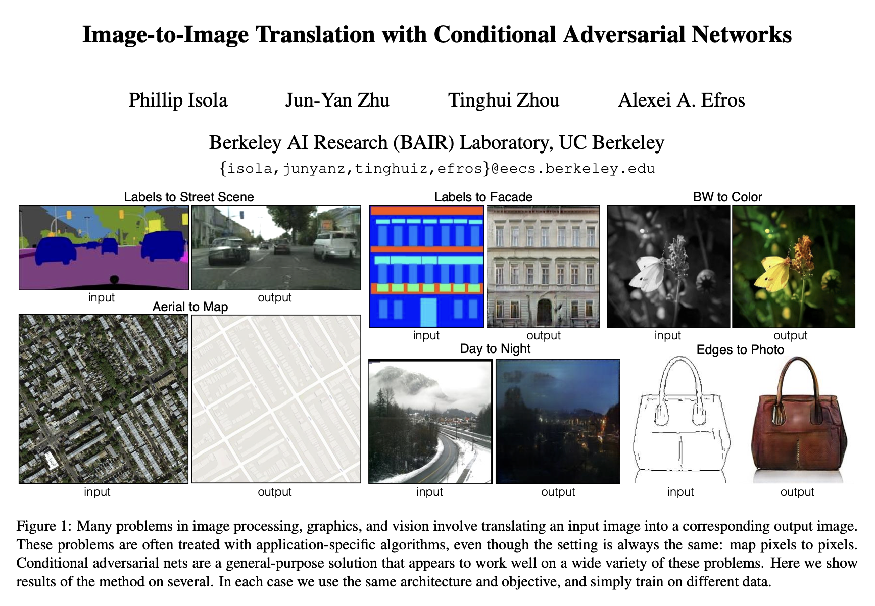
Pix2pix
Notes:
Pix2pix GANs is an implementation of Conditional GANs. It was originally introduced in the 2016 paper titled “Image-to-Image Translation with Conditional Adversarial Networks” #####The approach was presented by Phillip Isola and others.
This model is designed for general purpose image to image translation. In our project, we have utilized the pix2pix framework to tackle image translation tasks.

Slide 10
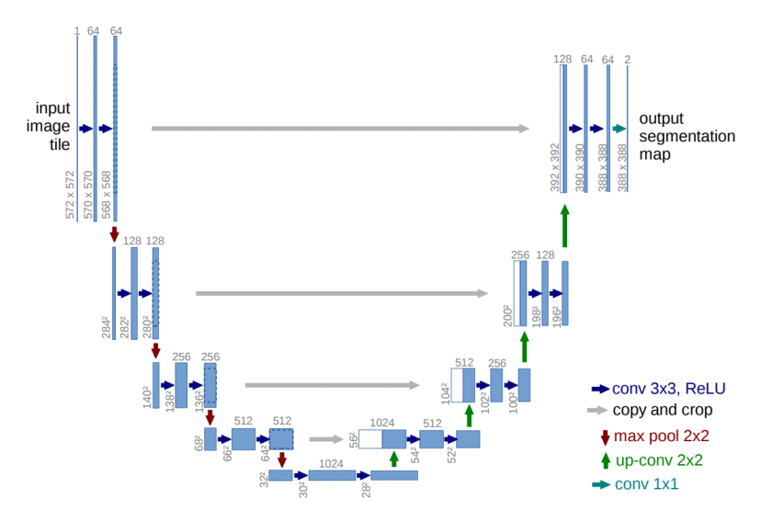
Generator Architecture
Generator consists of an Encoder and Decoder in a U-Net Architecture
Encoder: C64 - C128 - C256 – C512 - C512 - C512 - C512 – C512
Decoder(With Skip Connections): CD512 - CD1024 - C1024 - C1024 – CD1024 - C512 - C256 - C128
Skip-Connections - Helps recover all information lost during the downsampling of the input at Encoder
Notes:
Starting of with the Generator Architecture of the pix2pix gan, which is a U-Net.
##The U-Net architecture is a key component of the generator in pix2pix GANs. It's designed to capture both the local and global features of an image ###, enabling high-quality image-to-image translation.
As you can see from the example picture, The U-Net consists of an encoder and a decoder. The encoder gradually downsamples the input image, extracting and encoding its features. This process helps to capture the high-level contextual information. Meanwhile, skip connections are established between the encoder and decoder, preserving the low-level details.
The decoder takes the encoded features and progressively upsamples them. The skip connections allow the decoder to access the skipped information, which helps in retaining the fine details during the upsampling process.
##This architecture has proven to be successful in various image translation tasks.
Skip-connections are introduced, which help recover all information lost during the downsampling of the input at Encoder. During backpropagation, it even helps improve the gradient flow by avoiding the vanishing gradient issue.
we add skip connections, following the general shape of a “U-Net” [50]. Specifically, we
add skip connections between each layer i and layer n − i,
where n is the total number of layers. Each skip connection simply concatenates all channels at layer i with those
at layer n − i.

Slide 11
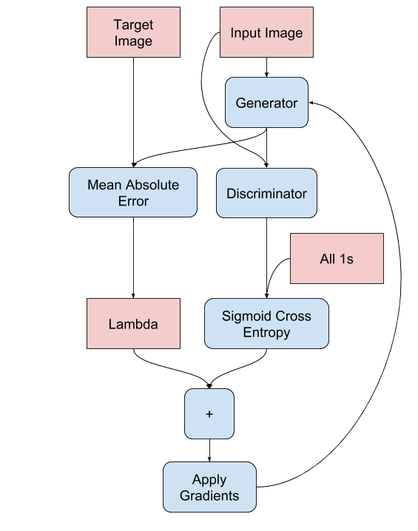
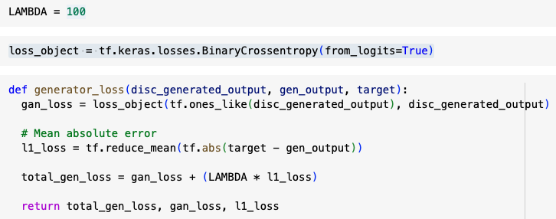
Generator Loss
The Generator Losses are calculated as follows:
Sigmoid Cross-Entropy loss (ADVERSARIAL LOSS) of the generated images and an array of ones.
L1 LOSS, which is a MAE (mean absolute error) between the generated image and the target image.
Total Generator Loss = LAMBDA*L1_LOSS + ADVERSARIAL LOSS
Notes:
The generator loss are calculated in two folds.
First of them is called the Adversarial loss which is a sigmoid cross-entropy loss of the Discriminators classification of the generated images and an array of ones.
And an L1 loss , which is a MAE (mean absolute error) between the generated image and the target image.
###This allows the generated image to become structurally similar to the target image.
The total generator loss is calculated as Lambda times the L1 loss plus the adversarial loss. Where lambda is the hyperparameter which is used to control the relative importance between the l1 loss and the adversarial loss.
In our model, we used lambda = 100 as suggested in the original paper. This places more emphasis on the making the generated image to become more structurally similar to the target image.
A higher value of lambda places more emphasis on the L1 loss, promoting the preservation of fine details and textures in the generated output.
The formula to calculate the total generator loss is gan_loss + LAMBDA * l1_loss, where LAMBDA = 100.
It was found that using the gan_loss alone gave sharper results but produced visual artifacts. With the addition of the L1 loss (with λ = 100) the artifacts are reduced.
The generator is updated via a weighted sum of both the adversarial loss and the L1 loss, where the authors of the model recommend a weighting of 100 to 1 in favor of the L1 loss. This is to encourage the generator strongly toward generating plausible translations of the input image, and not just plausible images in the target domain.

Slide 12
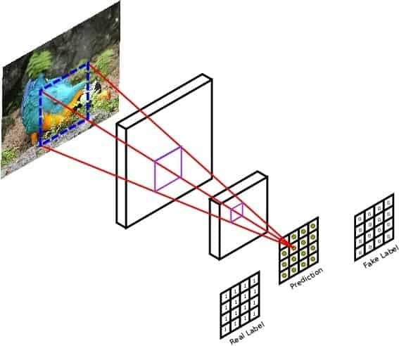
Discriminator Architecture (PatchGAN)
PatchGAN Architecture:
PatchGAN operates at the patch level, focusing on local image regions.
It enables fine-grained discrimination and feedback in image-to-image translation tasks.
The PatchGAN discriminator classifies each input patch as real or fake.
Architecture Components:
Input: Patch of an image (70x70 pixels).
Convolutional Layers: Extract features from the input patch.
Fully Connected Layer: Produces a single prediction per patch.
For a 256x256 Image, it produces a 30x30 prediction output
Notes:
Onto the Discriminator of our pix2pix GAN.
The discriminator component is known as PatchGAN.
Unlike traditional discriminators that classify the entire input image as real or fake, the PatchGAN discriminator focuses on evaluating local patches or sub-regions of the image. This allows for more fine-grained analysis of theimage ## and enables the generator to produce higher-quality translations.
The picture explains the working of an patchGAN. It operates by sliding a small window or patch over the input image and classify each patch as real or fake. This local evaluation helps the discriminator capture and understand the finer details and textures of the images.
###Results from the original paper states PatchGAN produces similar quality results when compared to an ImageGAN (which classifies the image as a whole). But PatchGAN has fewer parameters, runs faster, and can be applied to arbitrarily large images.
In our model, the patchGAN is designed in such a way that each output prediction of the model maps to a 70×70 patch of the input image. Hence, for a 256x256 image, we get a 30x30 prediction output which is then used to calculate the loss.
The benefit of this approach is that the same model can be applied to input images of different sizes, e.g. larger or smaller than 256×256 pixels.
By using patch-based discrimination, the pix2pix GAN can generate high-resolution outputs while preserving local image structures. This is particularly beneficial for tasks such as image-to-image translation, where maintaining local coherence and preserving details is essential.
Overall, the PatchGAN discriminator enhances the training process by providing more informative and localized feedback to the generator. It promotes the generation of realistic and visually appealing outputs that closely match the target domain.
Why Patch GAN?
Answer: N can be much smaller than the full size of the image and still produce high quality results. This is advantageous because a smaller PatchGAN has fewer parameters, runs faster, and can be applied to arbitrarily large images.

Slide 13
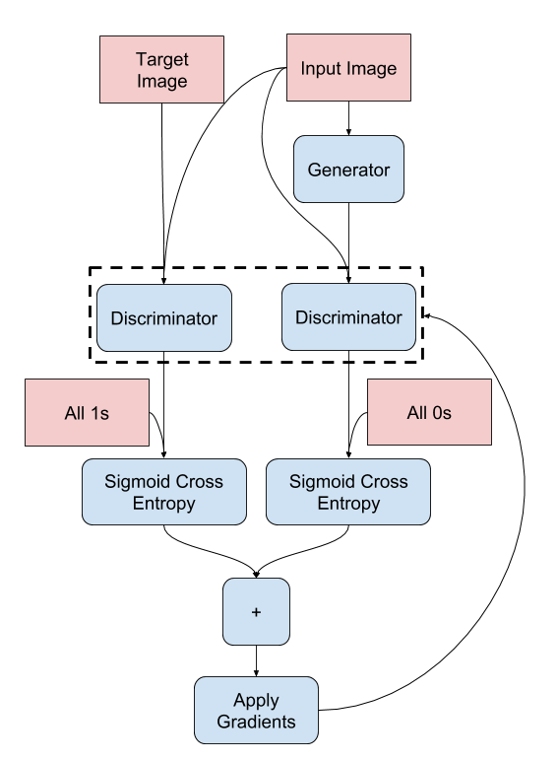
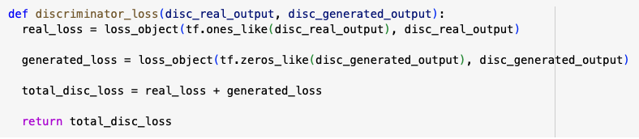
Discriminator Loss
The Discriminator loss takes 2 inputs: real images and generated images.
REAL_LOSS: is a sigmoid cross-entropy loss of the real images and an array of ones(since these are the real images).
GENERATED_LOSS: is a sigmoid cross-entropy loss of the generated images and an array of zeros (since these are the fake images).
TOTAL DISCRIMINATOR LOSS = REAL_LOSS + GENERATED LOSS
Notes:
In the discriminator, we calculate the real loss and the generated loss:
real_loss is a sigmoid cross-entropy loss of the real images and an array of ones(since these are the real images). Here we calculate how many of the real images did the discriminator classify as real.
Likewise, generated_loss is a sigmoid cross-entropy loss of the generated images and an array of zeros (since these are the fake images).Here we calculate how many of the generated images did the discriminator classify as fake.
The total discriminator loss is then then sum of both the real loss and the generated loss.
Since it’s a patchGAN there is a 0 or 1 for each patch in the image in a matrix output. The values of that marix are combined together to give a score.
The total_loss is the sum of real_loss and generated_loss.
Then the gradients of the sum of the losses is calculated.

Slide 14
Training Process
Training Process During Each "Training Step"
Generator
Input: Image
Output: Generated Image
Discriminator:
Input 1: Input Image + Target Image
Input 2: Input Image + Generated Image
Output 2: Discriminator Score for Input-Generated Pair
Loss Computation:
Generator Loss: Adversarial Loss + L1 Loss
Discriminator Loss: Sigmoid Crossentropy Loss
Gradients Calculation:
Generator: Compute gradients of Generator Loss w.r.t. Generator Variables
Discriminator: Compute gradients of Discriminator Loss w.r.t. Discriminator Variables
Optimizer Update:
Generator: Update Generator Variables using gradients
Discriminator: Update Discriminator Variables using gradients
Output 1: Discriminator Score for Input-Target Pair
Learning Rate: 0.0002
Momentum Parameter (beta): 0.5 for both the discriminator and generator.
Epoch Definition: In the context of training, going through all the training images once is considered as completing 1 epoch. For example, in the facades dataset with 400 training images, completing 400 training steps is equivalent to completing 1 epoch.
Notes:
During each training step:
The generator takes an input image and produces an output image.
The discriminator is invoked twice:
First, With an input image and the corresponding target image.
Second, With an input image and the generated output from the generator.
Losses are computed for both the generator and the discriminator.
Gradients of the losses with respect to the generator and discriminator variables are calculated.
The optimizer is then updated with the gradients applied to the respective variables.
Learning Rate: The learning rate is set to 0.0002, which determines the step size during optimization.
Momentum Parameter (beta): The momentum parameter (beta) is set to 0.5 for both the discriminator and generator. It controls the exponential decay rate of the first moment estimates of the gradients.
Epoch Definition: In the context of training, going through all the training images once is considered as completing 1 epoch. For example, in the facades dataset with 400 training images, completing 400 training steps is equivalent to completing 1 epoch.

Slide 15
Generator Training
Discriminator Training
Notes:
Training Steps:
For each example input the generator generates an output.
The discriminator receives the input image and the generated image as the first input, and the input_image and the target_image as the second input.
Calculate the generator and the discriminator loss
Calculate the gradients of loss with respect to both the generator and the discriminator variables (inputs) and apply those to the optimizer: alternating between one gradient decent step on D, then one on G
We alternate between one gradient descent step on D, then one step on G
Momentum Parameters, beta_1 = 0.5, beta_2 = 0.999, learning rate = 0.0002

Slide 16
The Datasets
Sourced from TensorFlow CycleGAN
Paired datasets
Random jitter was applied to all the images by resizing:
Random mirroring with 50% probability was applied to all the images.
For the maps dataset images were resized:
256 × 256
286 × 286
256 × 256
600 × 600
256 × 256
FACADES | SPLIT | INSTANCES
A: Photos | testA | 106
 | trainA | 400
B: Facades | testB | 106
 | trainB | 400
MAPS | SPLIT | INSTANCES
A: Aerial Maps | testA | 1098
 | trainA | 1096
B: Satellite | testB | 1098
 | trainB | 1096
https://www.tensorflow.org/datasets/catalog/cycle_gan#cycle_ganfacades
https://www.tensorflow.org/datasets/catalog/cycle_gan#cycle_ganmaps

Slide 17
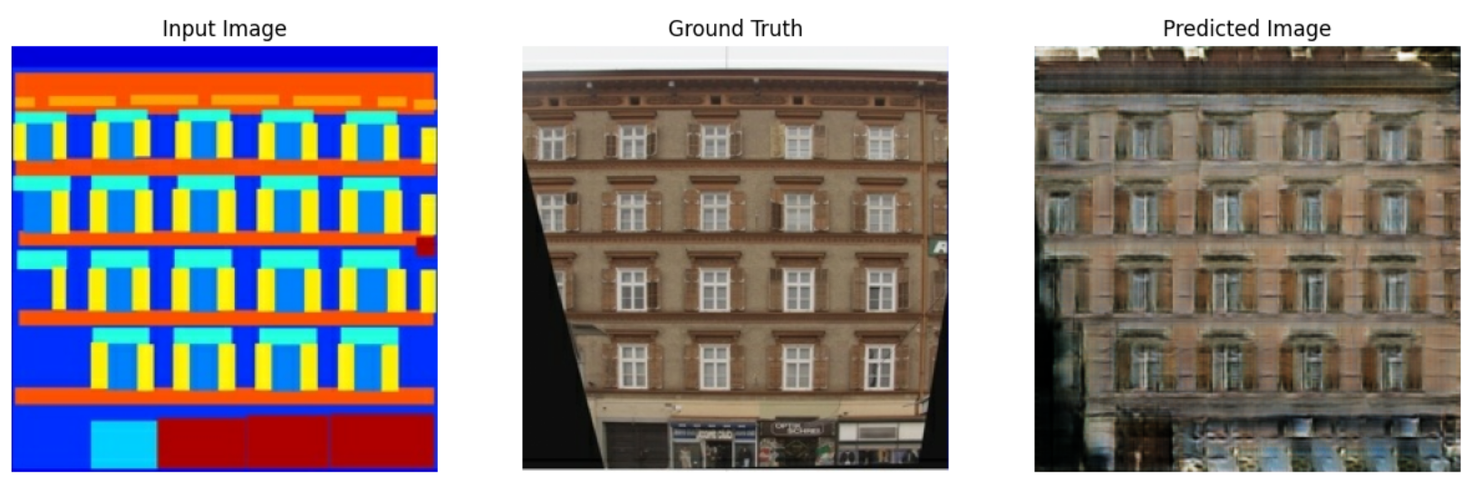
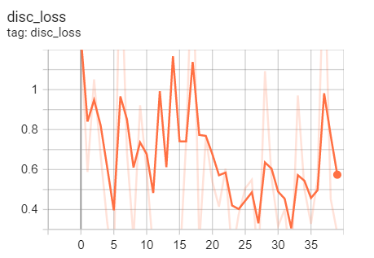
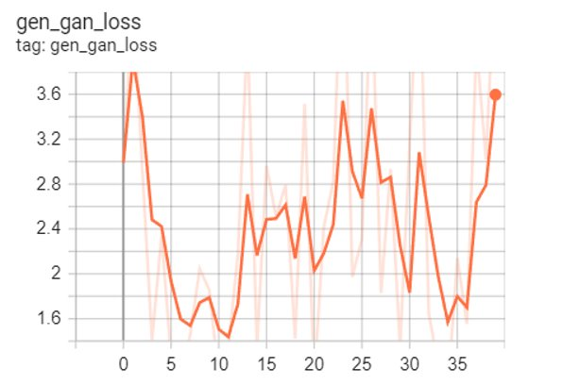
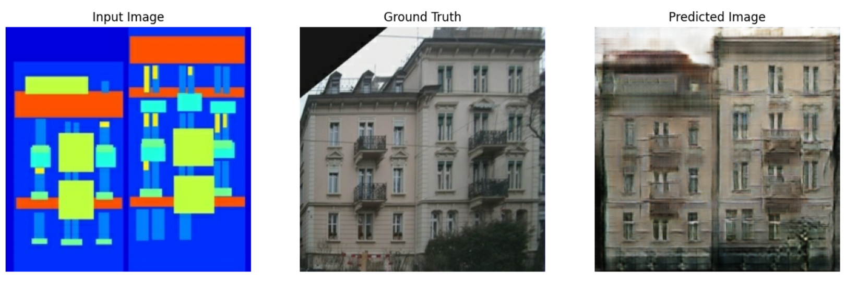
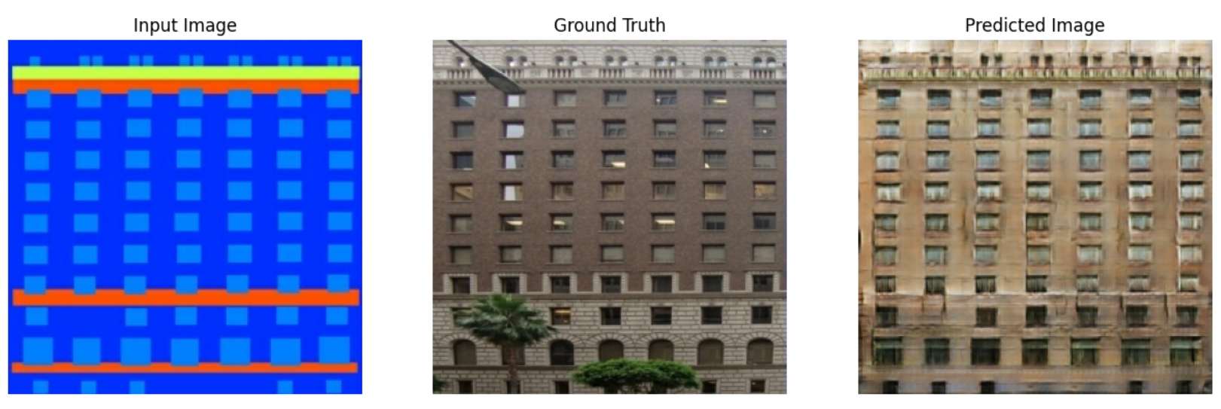
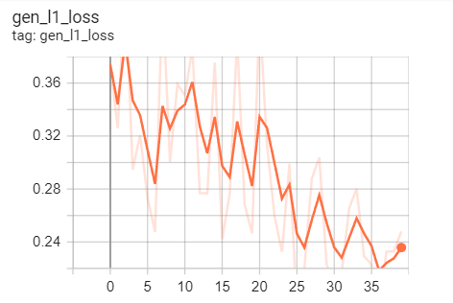
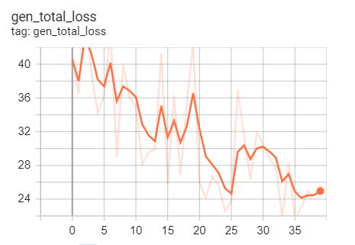
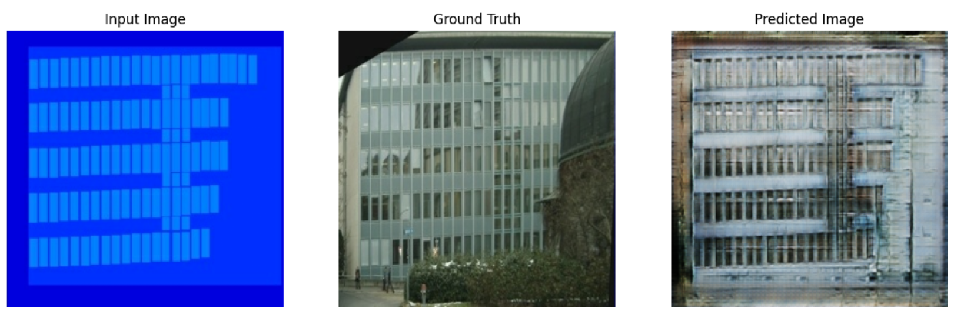
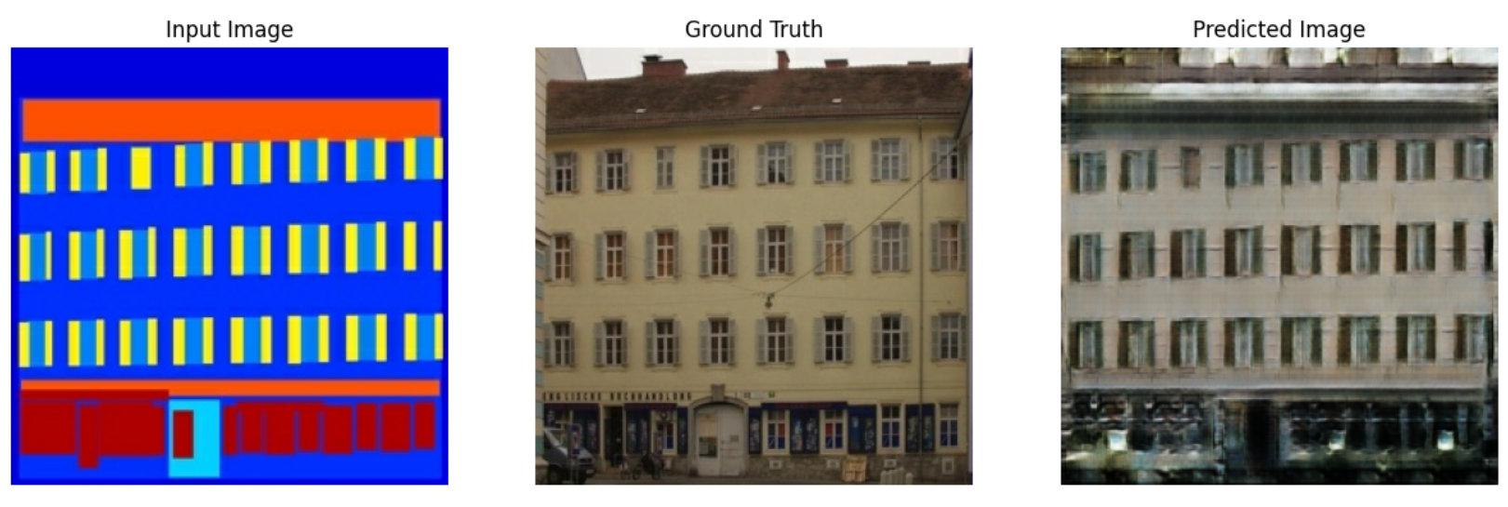
Results: Semantic to Photo
Dataset: Facades
Discriminator loss
Generator GAN loss
Generator L1 loss
Generator total loss
outputs obtained with cGAN after 100 epochs
Notes:
Interpreting the logs is more subtle when training a GAN (or a cGAN like pix2pix) compared to a simple classification or regression model.
Things to look for when interpreting the losses:
We want to check that neither the generator nor the discriminator model has "won". If either the gen_gan_loss or the disc_loss gets very low, it's an indicator that this model is dominating the other, and you are not successfully training the combined model.
So right now we are comparing the two top graphs: Discriminator loss and Generator GAN loss, and we see, which is a good sign, that which model is "winnng" oscillates equally between them. This is the "adversarial" nature.
The scales are different but this is to be expected since: "the discriminator loss represents the discriminator's performance in discriminating between real and generated images, while the generator loss reflects the generator's ability to deceive the discriminator. They are optimized through the adversarial training process, but their specific values and ranges may not necessarily be similar."
Discriminator loss: The value log(2) = 0.69 is a good reference point for these losses, as it indicates a perplexity of 2 - the discriminator is, on average, equally uncertain about the two options.
For the disc_loss, a value below 0.69 means the discriminator is doing better than random on the combined set of real and generated images.
For the gen_gan_loss, a value below 0.69 means the generator is doing better than random at fooling the discriminator.
As training progresses, the gen_l1_loss should go down. And this is what we see.

Slide 18
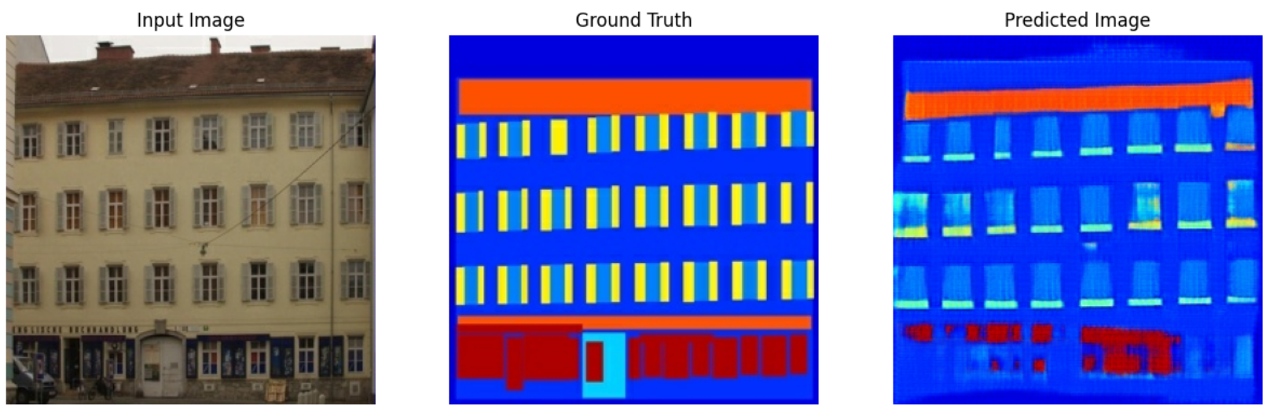
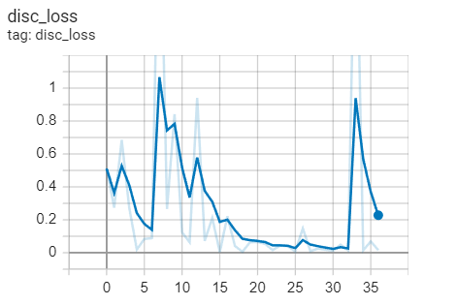
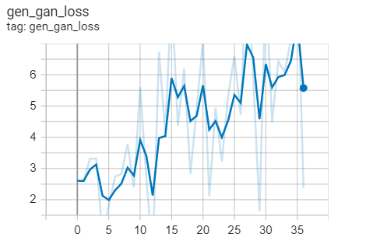
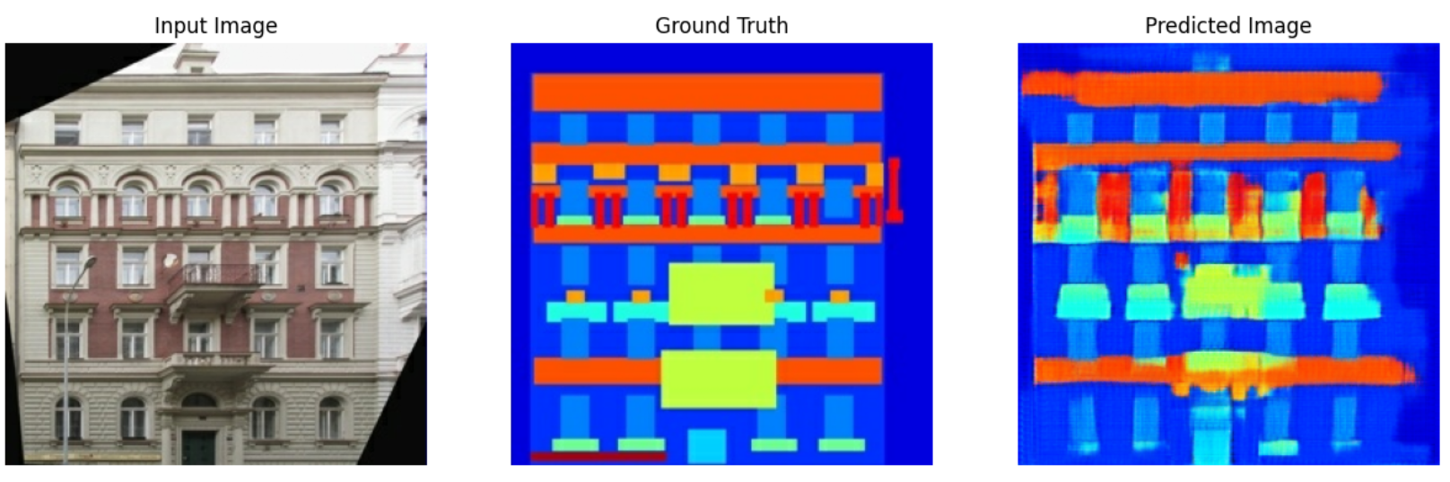
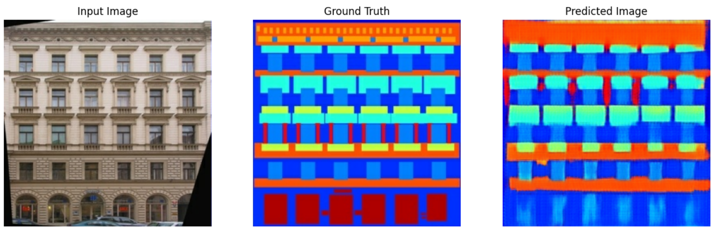
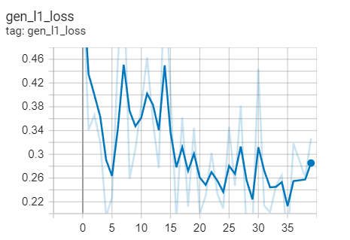
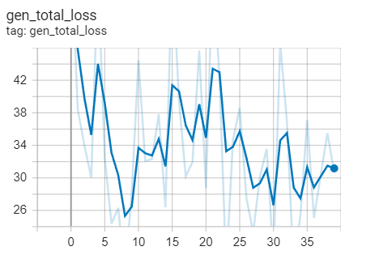
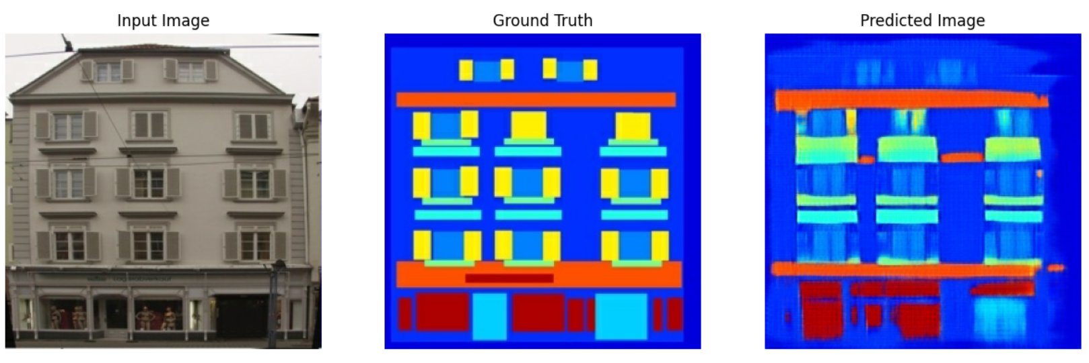
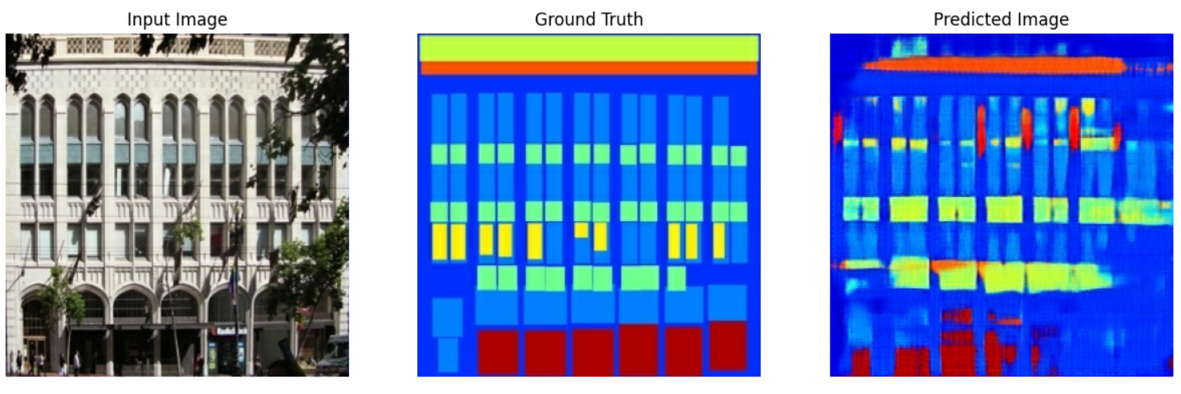
Dataset: Facades
Results: Photos to Semantic
Discriminator loss
Generator GAN loss
Generator L1 loss
Generator total loss
outputs obtained with cGAN after 100 epochs
Notes:
Here the discriminator wins and the generator loses. We think this is because of the task. This seems to have been a much easier task for the discriminator.
This could be because:
Its possible when going from real to semantic images the features learned by the discriminator might provide it an advantage over the generator. Although it may seem a simpler task at first moving from a real image to a semantic one, than the other way around, it requires the generator to know what details in the real image are structurally important, which is different than making a realistic image of a building given the important structural information given by the semantic image. You can see how it could be harder to fool the discriminator in this task.
The pix2pix architecture wasn't built for this task.
Looking at the performance of the loss functions is actually not the best measure of GAN performance. Often for these types of tasks, qualitative evaluation is the first step in evaluating GAN performance, so if the output is satisfying, the loss functions are not necessarily a problem.

Slide 19
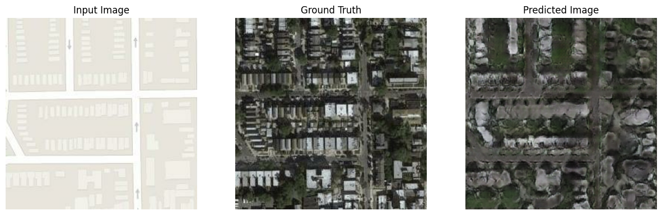
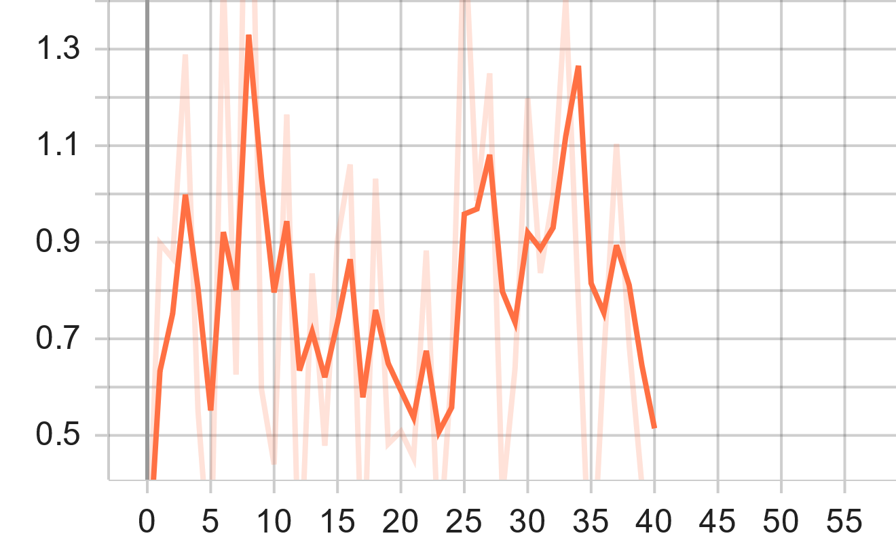
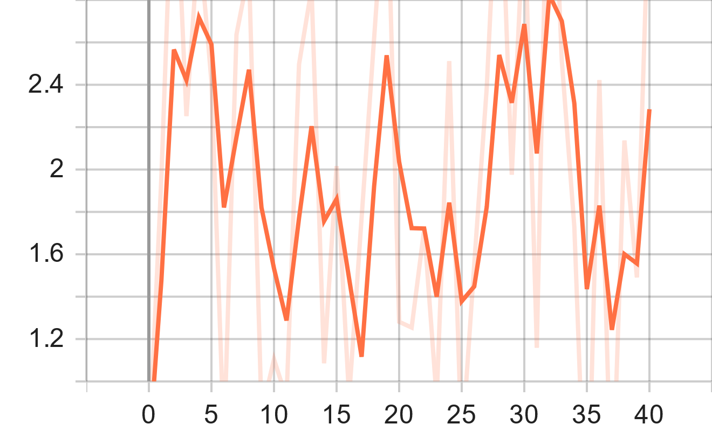
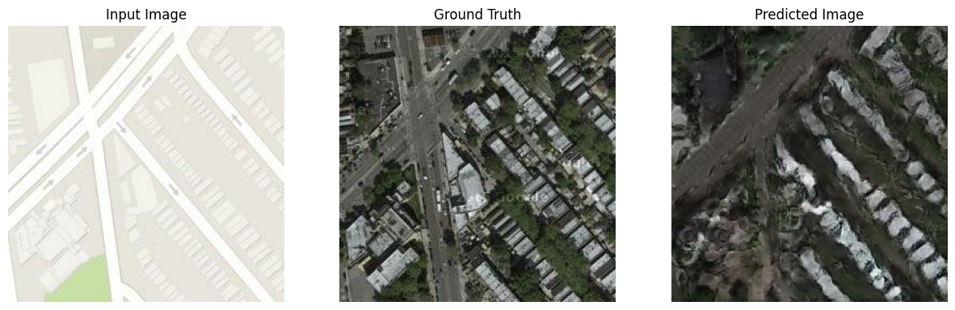
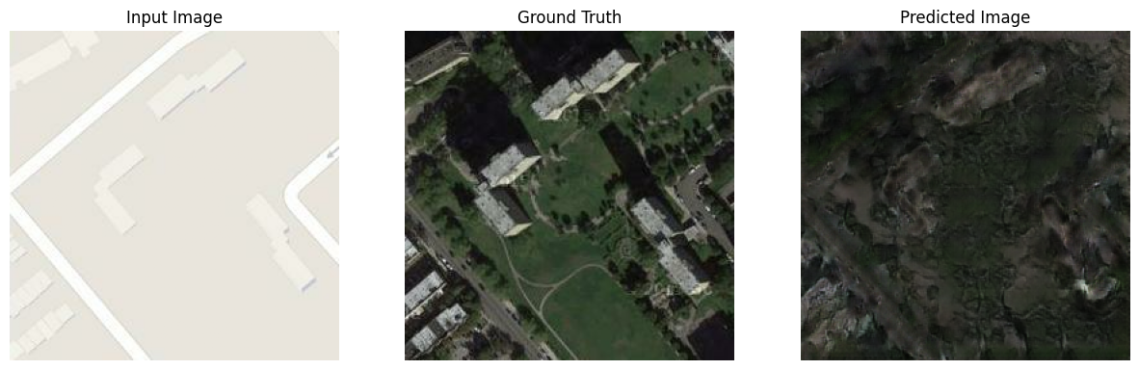
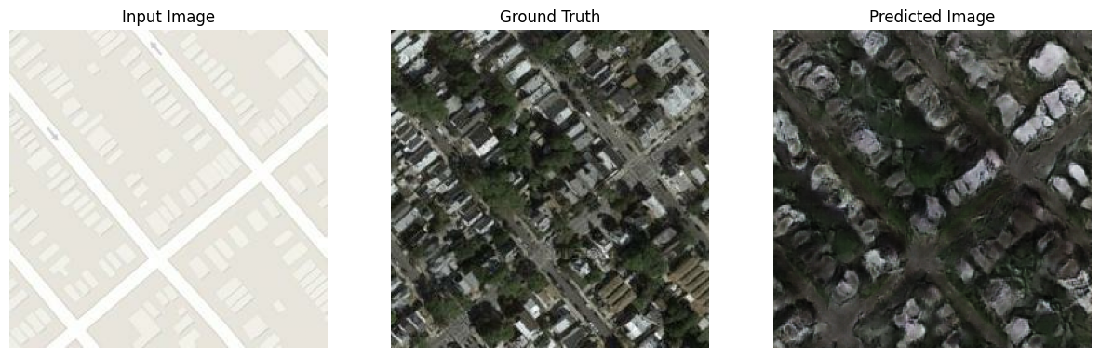
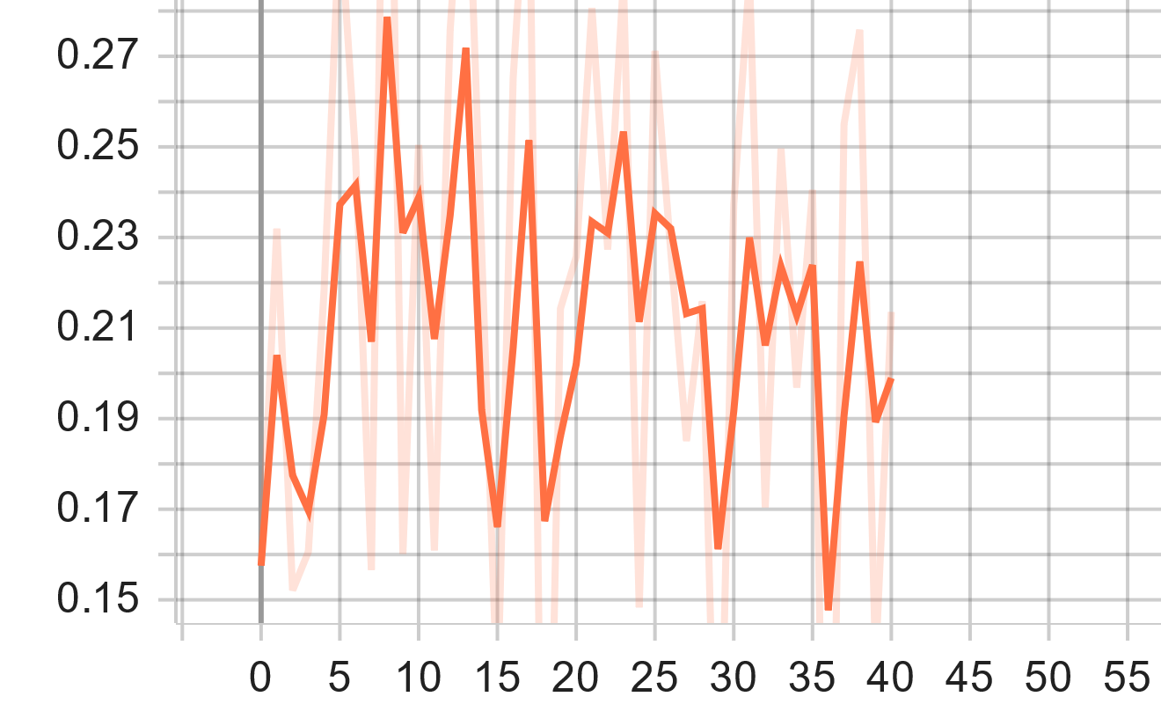
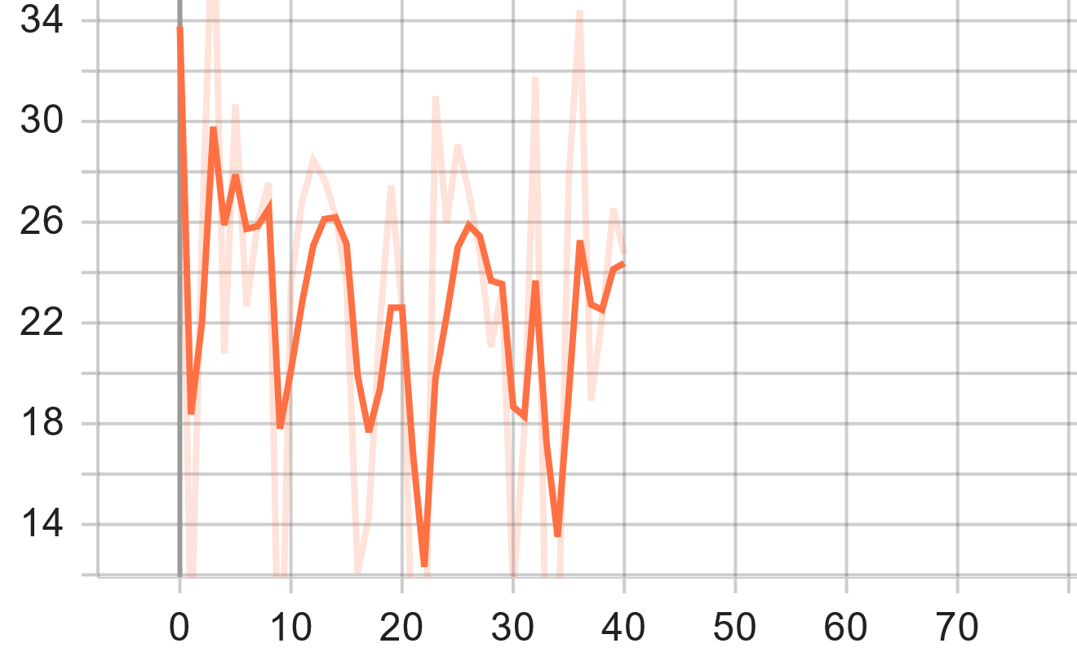
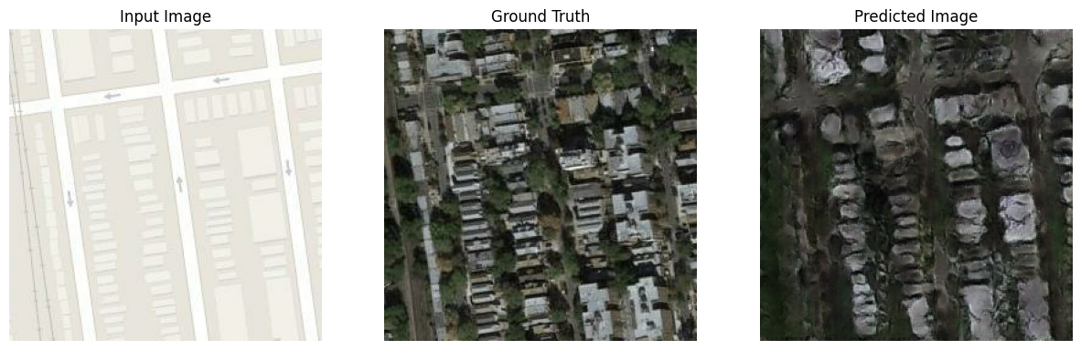
Dataset: Aerial views
Results: Map to Satellite
Discriminator loss
Generator GAN loss
Generator L1 loss
Generator total loss
outputs obtained with cGAN after 36 epochs
Notes:
The operations performed on this data set show less success during training because of the difference in size of the training datasets.
We had the model run for both datasets for 40,000 steps, since this was the limit of what we could manage given time and Colab GPU constraints.
The facades dataset had 400 images it was trained on –> Which ran for 40,000 steps which means it ran for 100 epochs.
The aerial dataset however had 1096 training images –> 40,000 steps = 36 epochs. In order to have 100 epochs like the facades dataset we would have had to run it for 109,600 steps.

Slide 20
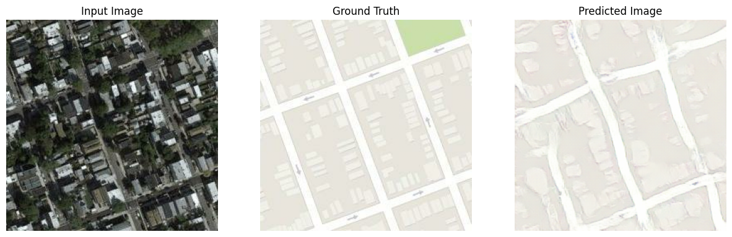
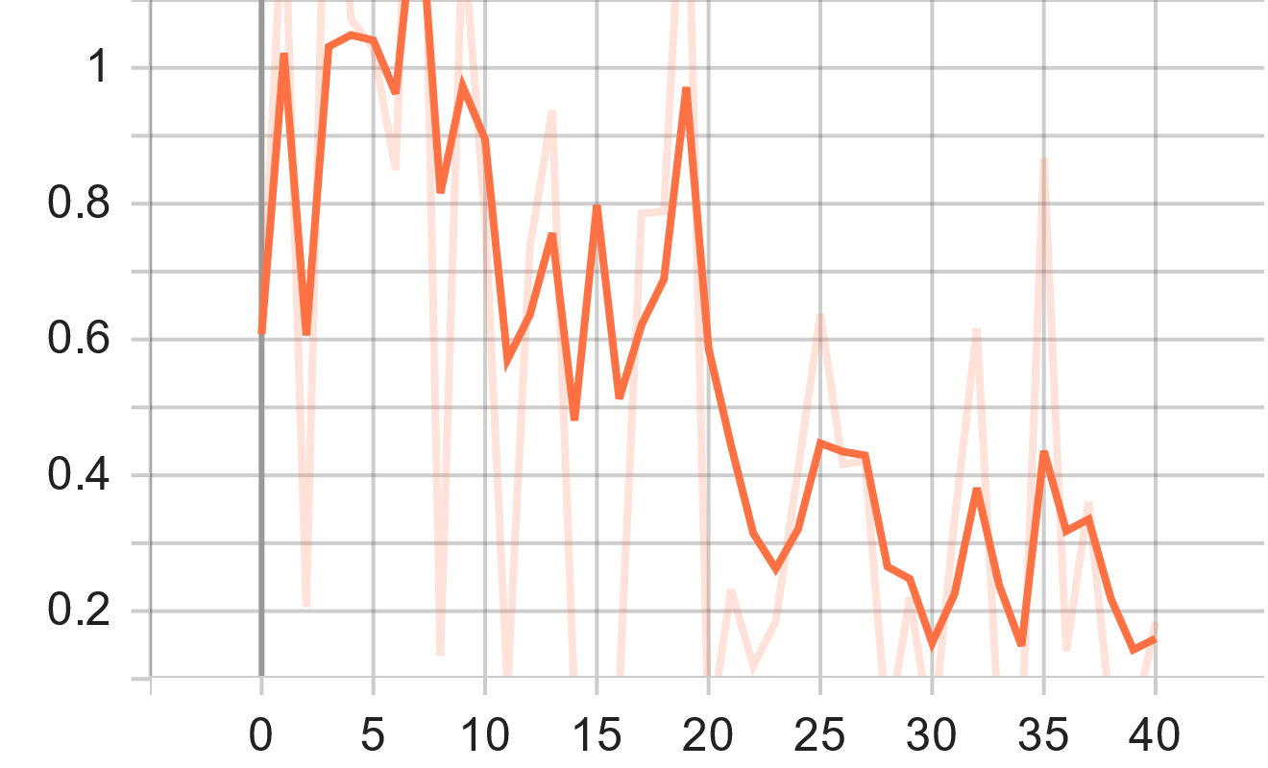
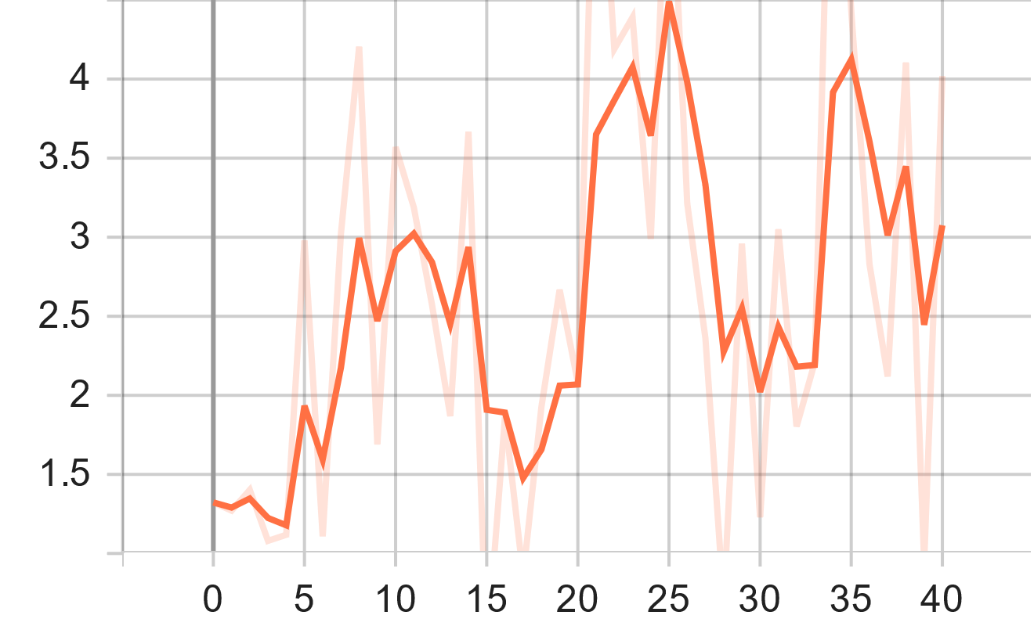
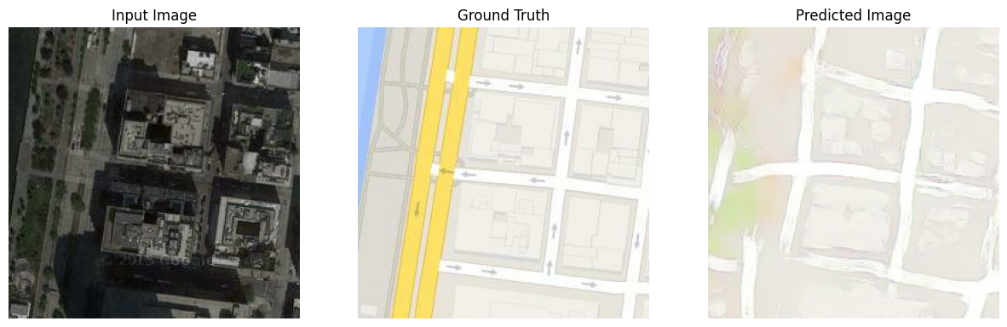
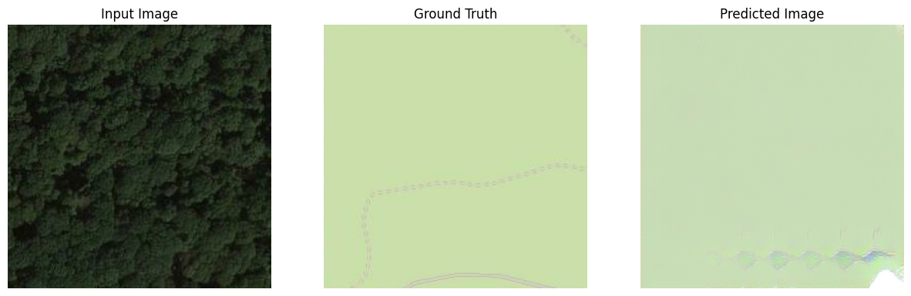
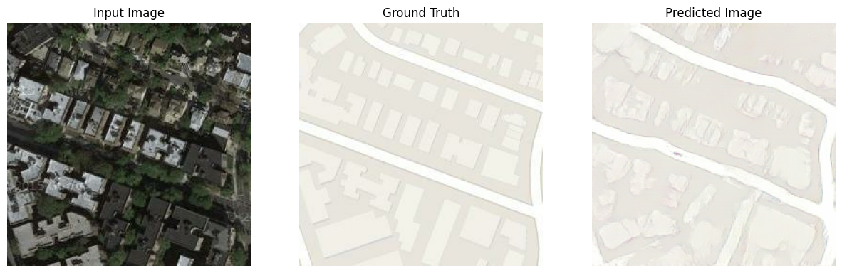
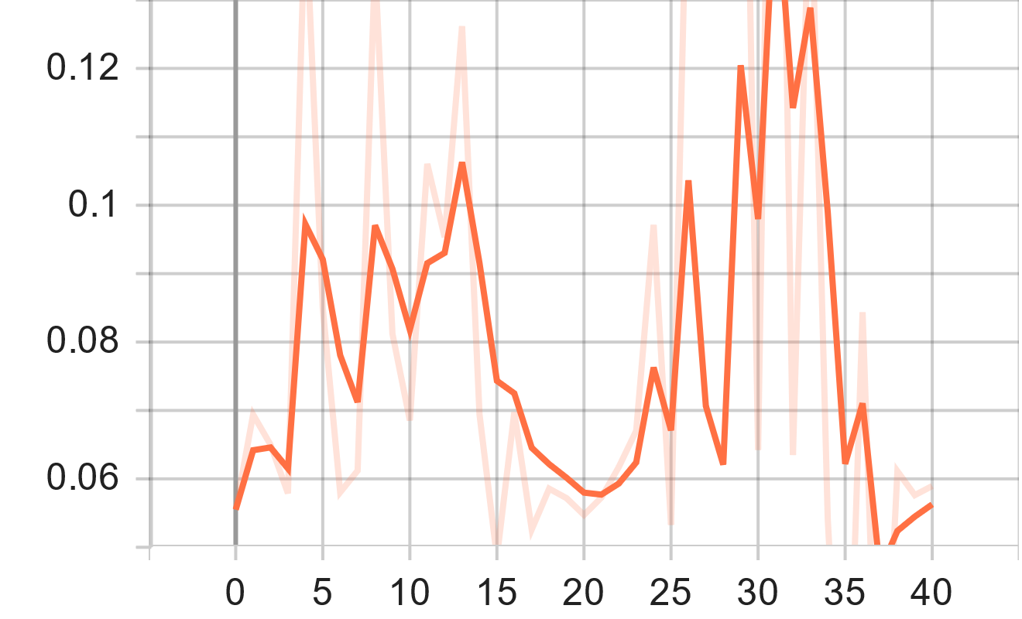


Dataset: Aerial views
Results: Satellite to Map
Discriminator loss
Generator GAN loss
Generator L1 loss
Generator total loss
outputs obtained with cGAN after 36 epochs
Notes:
Interestingly the GAN generator loss and discriminator loss for this task seems to show the same dynamics as with the facades dataset, where the generator loses and the discriminator wins.
This suggests that just in general, going from a real photo to a simplified schematic representation is a much harder job for the generator to generate than it is for the discriminator to discriminate.

Slide 21

CycleGANs
Introduced by Zhu et al. in 2017 and has gained significant attention in the field of computer vision.
CycleGAN is a variant of GANs designed for unsupervised image-to-image translation without paired training data.
CycleGAN can learn mappings between two different domains using unpaired data, where corresponding images are not required.
CycleGAN can learn to translate images from one domain to another using unpaired data, making it a powerful and flexible tool for image-to-image translation tasks.

Slide 22

CycleGANs
Architecture: Consists of two generator networks (G1 and G2) and two discriminator networks (D1 and D2).
Adversarial training: G1 and G2 compete against D1 and D2, respectively.
GAN objective: Generators aim to generate realistic images to fool the discriminators.
Cycle consistency: Introduces cycle consistency loss to enforce coherent mappings in both directions.
Forward pass: G1 converts images from domain A to domain B, while G2 converts images from domain B to domain A.
Backward pass: G1 and G2 reconstruct the original images from the translated images to ensure cycle consistency.
Training process: Alternates between adversarial training and cycle consistency loss minimization.
Result: The network learns mappings between domains without requiring paired data.

Slide 23










Dataset: Facades
Graphical Results
Semantic to Photos
Photos to Semantic
outputs obtained with CycleGAN after 25 epochs

Slide 24
Cycle vs Conditional GANs
 | Cycle GAN | Conditional GANs
Type of GAN | Unpaired image-to-image translation | Paired image generation and translation
Training Data | Unpaired data | Paired data
Training Process | Adversarial training + Cycle consistency loss | Adversarial training + Conditioning on input conditions
Data Flexibility | Handles unaligned datasets | Requires explicit correspondences
Attribute Control | Limited control over attributes | Precise control over attributes
Applications | Style transfer, domain adaptation, image-to-image translation | Image synthesis, text-to-image generation, image-to-image translation with paired data

Slide 25
Thank You For Watching!

Slide 26
Future Work
Tuning (espacially the CycleGAN)
Run Extensive training for the maps dataset in conditional GANs
Different types of datasets (especially unpaired data)
Other types of GANs: e.g. Self Attention GAN can better manage translation with important geometrical changes (such as cat to human)

